Slide 1
LIBRARY MANAGEMENT SYSTEM
TEAM MEMBERS:
UMANG SAXENA PL0122181
KAMANA TRIVEDI PL0122189
SHAILJA THAKUR PL0122202
MADHAVI KENGUVA PL0122205
CHAKALI PAVAN KUMAR PL0122201

Slide 2
INTRODUCTION
Library management system is a project which aims in developing computerized system to maintain all the daily work of library.
It has the facility of admin login through which admin can monitor the whole system.
Admin modules are add new book, view books, issue book and return book.
Overall this project of ours is being developed to help the library administration , maintain the library in the best way possible and also reduce the human efforts.

Slide 3
OBJECTIVE
The main objective of library management system is to manage the details of books, students , book issue and return book.
It manages all the information about book issue and return .
develop an online system to help the users(librarian’s).
To manage the distribution and collection books.
To track the records and to modify

Slide 4
PURPOSE
The purpose of library management system is to automate the existing system by the help of computerized equipment and full fledged computer software, fulfilling their requirements,
so that their Valuable data/information can be stored for a longer period with easy accessing and manipulation of the same.
This project also helps in administrative work such as keep information of book issue and return.

Slide 5
REQUIREMENTS
Windows version 7+
Front end Software: Html , CSS , java script.
Backend software: Java, Spring Boot, Spring Data JPA, Spring Security, Database.

Slide 6
PROJECT SCOPE
Our project aims to safe and easy handling of library. i.e. we have made a computerized process to store data and distribution.
It satisfies the admin(librarian).
It is easy and safe to store data.
It is easy to operator.
Have a good user interface.
It saves time and function faster.
It helps the Librarian to handle the library.
We have tried to develop safe and secure software with above mentioned specifications.
Scope of change: barcoding reading.

Slide 7


USED TOOLS AND TECHNOLOGIES
Frontend: Html and CSS.
Back end: Spring tool suite
MySQL Database.
Online tools:
Word pad
Notepad

Slide 8
MODULES:
We have admin module along with that we have some other modules:
Student info!.
Add book.
Add student.
Issue book.
Return book.
All records.
Fine payment.
Search book.

Slide 9
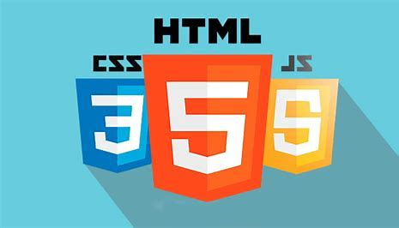
FRONTEND
HTML
CSS
JAVA SCRIPT

Slide 10


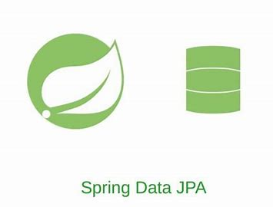



BACKEND/DATABASE
JAVA
SPRING BOOT
SPRING DATA JPA

Slide 11
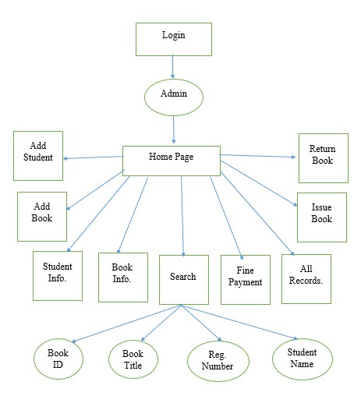
DATA FLOW DIAGRAM

Slide 12
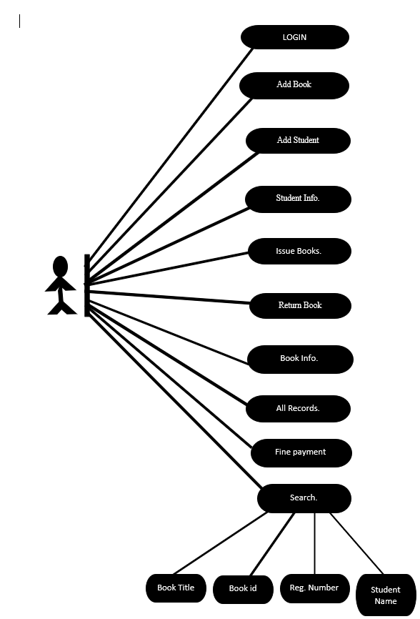
USE CASE DIAGRAM
A use case depicts a series of steps that give something significant value to an actor and is drawn as a horizontal ellipse.
A use case diagram apprehends the functional features of a system with processes implement in the system.
While discussing the functionality and procedures of the framework,
you discover important characteristics of the framework that you represent in the use case diagram

Slide 13
CONCLUSION AND FUTURE SCOPE
Future scope:
This application involves almost all the basic features of library management.
The future implementation will be help for the students.
Conclusion:
the project entitled “library management system” is developed using Html and CSS as frontend and OracleSQL database in backend to computerize the process of online management of books, issued and returned books. This projects covers only the basic features required.

